Slide 1

COSC 1336 Fundamentals of Programming I
Fall 2025

Slide 2
COSC 1336 Fundamentals of Programming I
Ally
512.299.6402
mally@austincc.edu
Email Subject
The subject for email correspondence to the instructor needs to include: COSC 1336(09)

Slide 3
Instructional Methodology
COSC 1336 Fundamentals of Programming I
This is a fully online 9-week course. The class will officially begin on June 2, 2025, and conclude on August 3, 2025.
There are no scheduled live or in-person class meetings. All course materials, projects, quizzes, and exams will be accessible through Blackboard, the college's learning management system.
Students are expected to stay on schedule, complete projects by the posted due dates, and engage actively with the course materials each week.
Please plan accordingly and ensure consistent access to a reliable computer and internet connection throughout the semester.

Slide 4
The 3s’ of Learning
COSC 1336 Fundamentals of Programming I
Syntax | Semantics | Style
Syntax in language dictates how words come together to form coherent sentences. | Semantics refers to the meaning or interpretation of code. | Consistent and well-defined coding styles contribute to code readability, maintainability, and collaboration among team members.
Syntax refers to the rules/structure that dictate how programming languages are written and interpreted by computers. | Data Manipulation: how data is processed and manipulated within a program. | consistent line breaks, spacing around operators, white spaces, and alignment of code elements
Basic Elements: variables, data types, operators. | Flow Control: Semantics govern the flow of execution within a program, determining which statements are executed and in what order. | Naming conventions typically involve using camelCase, snake_case, or PascalCase for identifiers, depending on the language and context.
Syntax Rules: Coding languages have strict syntax rules that dictate how code should be structured. | Error Handling: Semantics also encompass how errors and exceptions are handled within a program. | Clear and expressive names help convey the purpose and intent of code elements, making the code easier to understand and maintain
Expressions and Statements: In coding languages, expressions are combinations of variables, operators, and values that equate to a single value. | By understanding the semantics of coding, developers can write code that is not only syntactically correct but also efficient, robust, and maintainable. | While readability and maintainability are paramount, optimizing critical sections of code can improve overall application performance.
Practice, attention to detail, and familiarity with language-specific syntax are key to becoming proficient in coding. |  | Following best practices for branching, merging, and commit messages ensures a smooth and organized workflow.

Slide 5

3s’ of Learning - Semantics
COSC 1336 Fundamentals of Programming I
function calculateRectangleArea (width, height){
return width + height;
}
// semantic error
we should multiply length and width

Slide 6
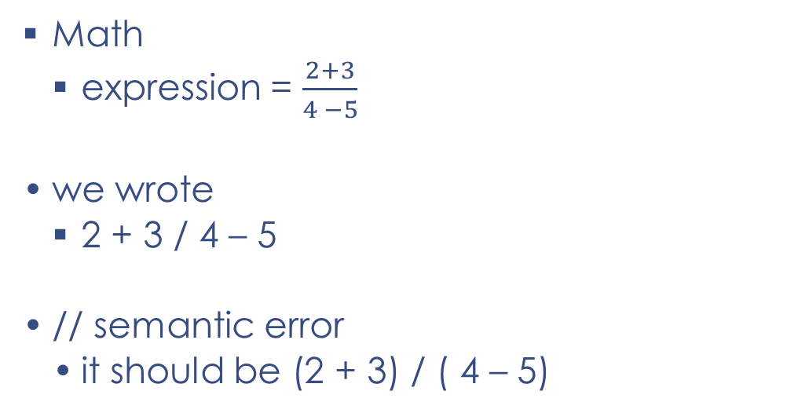
3s’ of Learning - Semantics
COSC 1336 Fundamentals of Programming I
Math
expression = $\frac{2+3}{4 −5}$
we wrote
2 + 3 / 4 – 5
// semantic error
it should be (2 + 3) / ( 4 – 5)

Slide 7
Yes Factor
COSC 1336 Fundamentals of Programming I
Embracing a positive mindset and believing in your ability to learn and succeed are powerful catalysts for personal growth and achievement.
Self-Efficacy: Believing in your capabilities to learn and succeed increases your self-efficacy, which is your belief in your ability to accomplish goals and overcome challenges. With a positive attitude, you approach tasks and obstacles with confidence and determination.
Resilience: Instead of being discouraged by failures or setbacks, you view them as opportunities for learning and growth.
Motivation: A can-do attitude fuels motivation and drive, inspiring you to set ambitious goals, pursue your passions, and take proactive steps towards achieving success.
Openness to Learning: Embracing a growth mindset encourages a willingness to learn new things, explore new ideas, and step out of your comfort zone.
Optimism helps you stay upbeat, resilient, and solution-oriented, even when faced with challenges or setbacks.
With confidence in yourself, you're more likely to take on challenges, speak up for yourself, and pursue your goals with conviction.
You're not afraid to make mistakes or face challenges because you understand that each experience is an opportunity to learn and grow.
By maintaining a positive mindset, believing in yourself, and embracing the journey of learning and growth, you can achieve your goals and fulfill your potential.

Slide 8

Path to a successful semester Remember to stay focused, stay positive, and celebrate your accomplishments along the way!
COSC 1336 Fundamentals of Programming I
Organize Your Tasks
@Tasks
@Home
Check BB information
Review Text chapters
Complete projects
Check DUE dates
Take exams
Set Realistic Goals
Manage Your Time Effectively
Break Tasks Into Smaller Steps
Start Early
Seek Clarification
Review and Revise
Stay Communicative
Submit On Time
Review PPT
Trace example codes
Take quizzes
Practice coding

Slide 9
COSC 1336 Fundamentals of Programming I
Communicate
The best way to communicate is via email.
You can text message on issues that need immediate attention.
If you want to schedule a one-on-one meeting, you can email me for an appointment.

Slide 10
COSC 1336 Fundamentals of Programming I
Blackboard
Please note that schedule changes may occur during the semester.
Any changes will be posted on Blackboard.

Slide 11
COSC 1336 Fundamentals of Programming I
Compassion
Empathy
Kindness
Respect
Treat others in the class with the respect and courtesy that you would want for yourself and that reflects professional.

Slide 12
COSC 1336 Fundamentals of Programming I
Netiquette
Demonstrate active listening/understanding by summarizing your respondent’s points briefly before responding (whether agreeing or disagreeing).
Collegial Learning and Collaboration with each other is the foundation to successful completion of the course.

Slide 13
COSC 1336 Fundamentals of Programming I
Learning Tools
Blackboard – Course Information
File/Folder Management
Access eTextbook
Install Python

Slide 14

COSC 1336 Fundamentals of Programming I
Keep It Simple Students

Slide 15
COSC 1336 Fundamentals of Programming I
Computer with audio/Internet access
Install Python
Black Board – Course Information

Slide 16
Course Description
COSC 1336 Fundamentals of Programming I
Introduces the fundamental concepts of structured programming.
Topics include
software development methodology
This course assumes computer literacy
data types
control structures
functions
list/tuples/dictionaries/sets
mechanics of running, testing, and debugging
Object Oriented Programming

Slide 17
Learning Outcomes
COSC 1336 Fundamentals of Programming I
Derive problem specifications from problem statements.
Develop algorithms using modular design principles to meet stated specifications.
Create code to provide a solution to problem statements ranging from simple to complex.
Test and debug programs and program modules to meet specifications and standards.

Slide 18
Learning Objectives
COSC 1336 Fundamentals of Programming I
Create programs that contain clear and concise documentation.
Incorporate both basic and advanced control structures appropriately into algorithms.
Demonstrate an understanding of structured design by implementing programs with functions, including parameter passing and value returning.
Implement programs that use data types and demonstrate an understanding of numbering systems.

Slide 19
Learning Objectives
COSC 1336 Fundamentals of Programming I
Implement programs using classes, strings and files.
Implement algorithms using one-dimensional and indexed data structures.
Demonstrate an understanding of list/tuples/dictionaries/sets: searching and sorting algorithms by desk-checking and/or modifying algorithm implementations.
Design and implement simple classes.

Slide 20
Course Rationale
COSC 1336 Fundamentals of Programming I
This is an entry level programming course designed to teach students the basic concepts of computer programming.
The course will include designing, coding, debugging, testing, and documenting programs using a high level programming language.
This course is intended to prepare students for a programming-oriented academic path.
The course is included in several degree plans.

Slide 21
Text Book
COSC 1336 Fundamentals of Programming I
Starting out with Python – Fourth Edition
Author: Tony Gaddis
Publisher: McGraw-Hill, 2020.
ISBN-13: 978-0134543666
The textbook is part of the all-inclusive with the course, you will have it available the first day of class through Blackboard. You will need the textbooks to follow the class.
To access the textbook, logon to Blackboard, click on the “Course Textbook” link and follow the instructions

Slide 22
Course Grade Distribution
COSC 1336 Fundamentals of Programming I
Exams
(60%)
Exam 1
Exam 2
Projects
(25%)
10 projects
Quizzes
(10%)
10 Quizzes
Exam 3
Engagement (5%)
On-time completion
Plus more….

Slide 23
Course Policies
COSC 1336 Fundamentals of Programming I
Grade Disputes
Withdrawal | Drop
Use of Black Board
Communication

Slide 24
Academic Policies
COSC 1336 Fundamentals of Programming I
Incompletes
Students With Disabilities
Academic Honesty

Slide 25
Academic Policies
COSC 1336 Fundamentals of Programming I
Incompletes
Honor Code
Students With Disabilities
Academic Honesty

Slide 26
Projects
COSC 1336 Fundamentals of Programming I
Check Blackboard – Requirements | Due dates | Start File
Review Documentation and Style Requirements

Slide 27
WORLD OF DATA
COSC 1336 Fundamentals of Programming I
Database
Data
Information
Knowledge/Business Intelligence

Slide 28
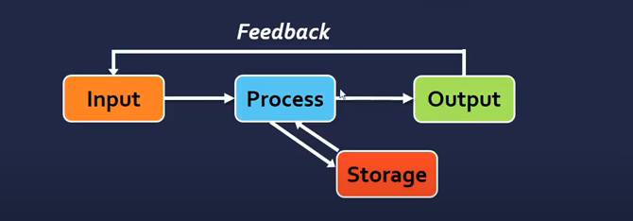
Data Flow Model
COSC 1336 Fundamentals of Programming I

Slide 29
COSC 1336 Fundamentals of Programming I
Install Python- check BB for install guidelines
Learn to Use Python - How to Run My First Python program

Slide 30
Programming Requirements
COSC 1336 Fundamentals of Programming I
20% of your grade on each programming assignment will be based on program documentation and style.
Documentation/Programming Styles Requirements
Each program must begin with comments that include:
your full name/project number/date of submission/program completion
At least 3 lines of description to summarize what the program does.
In your source file, the code for other functions should come main()
Each function should begin with a 1 to 3-line comments describing what the function does.
All local variables and constants should be declared inside the function and at the beginning of the function block.
Use meaningful variable names. One- or two-character names are rarely meaningful.
Declare one variable/statement per line.

